Slide 1

INT 221 - MVC PROGRAMMING
File and Folder Structure

Slide 2
Directory/Application Structure
Important File and Folder
Where we create MVC Files
Basics of all folders

Slide 3
Root Directory (Project Name)
When we build Project:
laravel new project_name

Slide 4
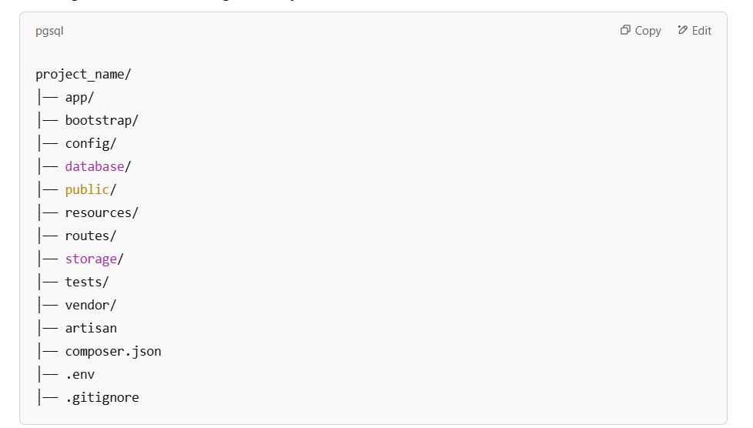
Directory Structure

Slide 5
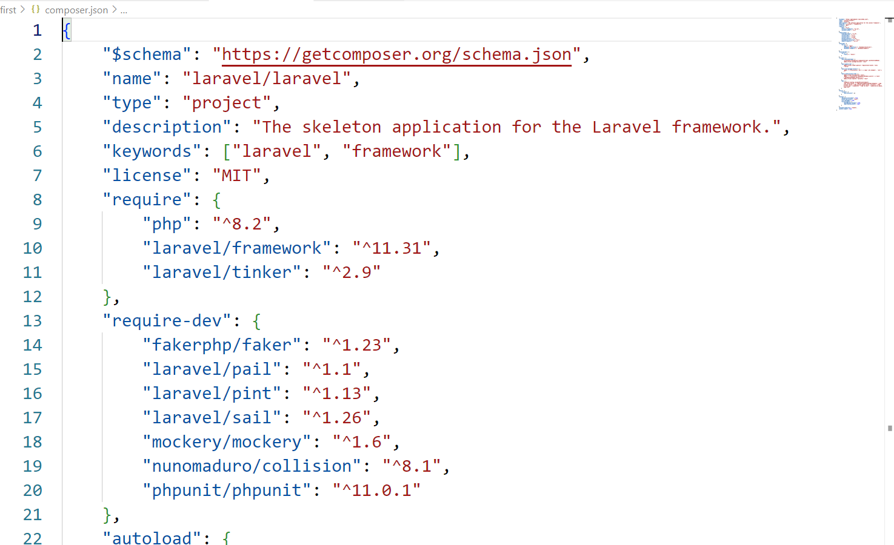
composer.json- Defines Composer dependencies

Slide 6
composer.json file-Project Details and dependencies
Used to manage the project’s PHP dependencies. It is a JSON file that defines the metadata, dependencies, and scripts for the project.
When you run Composer commands, like composer install or composer update, the composer.json file guides Composer in fetching and managing dependencies.

Slide 7
composer.json file-Beaware of deleting
If deleted, and file can’t be recovered then it is impossible to start the Laravel project
Contains Details of the project
Eg. Version of PHP, Version of Laravel
Contains dependencies, libraries

Slide 8
Key Sections of composer.json in Laravel
name: Specifies the package name in the format vendor/package.
"name": "laravel/laravel"

Slide 9
description: A short description of the project.
"description": "The Laravel Framework."

Slide 10
require: Lists the dependencies required for the project to work. Laravel uses specific versions of libraries.
"require": {
"php": "^8.0",
"laravel/framework": "^10.0",
"guzzlehttp/guzzle": "^7.0"
}

Slide 11
require-dev: Specifies development dependencies like testing tools.
"require-dev": {
"fakerphp/faker": "^1.9.1",
"phpunit/phpunit": "^9.5"
}

Slide 12
autoload: Configures the autoloading for PHP classes. Laravel primarily uses the psr-4 autoloading standard.
"autoload": {
"psr-4": {
"App\\": "app/"
}
}

Slide 13
autoload-dev: Defines autoloading for development-only files, often used for tests.
"autoload-dev": {
"psr-4": {
"Tests\\": "tests/"
}
}

Slide 14
Vendor
All the dependencies mentioned in the Composer.json file are stored in vendor folder

Slide 15
Vendor folder (mentioned in composer.json and stored in Vendor)
The vendor folder in a Laravel project is where Composer stores all the third-party dependencies required for the application.
It is automatically generated and managed by Composer and includes libraries, frameworks, and tools specified in the composer.json file.

Slide 16
Autoloading:
The vendor/autoload.php file is the main entry point for Composer's autoloading mechanism.
Laravel's bootstrap/app.php includes this file to autoload all necessary classes

Slide 17
Organizational Structure:
Dependencies are organized in subdirectories based on their namespaces (e.g., vendor/symfony/, vendor/laravel/).
It also contains the composer/ directory, which manages autoloading and metadata about the dependencies.

Slide 18
App Folder
Contains the core code of the project
The app folder in Laravel is a key directory where most of your application logic resides.
It is where you define the core of your application, including its business logic, controllers, models, service provider and other components.

Slide 19
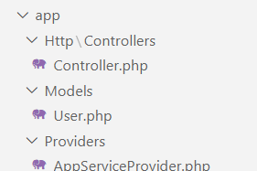
App Folder in Laravel

Slide 20
Providers
Stores service provider classes.
Service providers are responsible for bootstrapping your application.
By default, Laravel includes several providers, such as AppServiceProvider, AuthServiceProvider, and EventServiceProvider.

Slide 21
routes/web.php (opened at which link)
In Laravel, the routes/web.php file is where you define routes for web interfaces of your application.
These routes typically respond to requests made via a web browser and are grouped within the web middleware group, which provides features such as session handling, CSRF protection, and cookie encryption.

Slide 22
Structure of web.php
Route::get('/uri', function () {
return 'Response';
});

Slide 23
Common HTTP Methods:
GET: For retrieving data (e.g., showing a form or page).
POST: For submitting data (e.g., processing forms).
PUT/PATCH: For updating data.
DELETE: For deleting data

Slide 24
Basic Route Example:
Route::get('/', function () {
return view('welcome');
});

Slide 25
routes/console.php file (Console commands)
The routes/console.php file in Laravel is where you define all custom Artisan commands for your application.
This file allows you to extend and customize the functionality of Laravel's command-line interface (CLI)/terminals.
Not used directly

Slide 26
Resources Folder (Contains Views)
In Laravel, views are used to separate the presentation layer from the business logic of your application.
Views are typically HTML templates that are located in the resources/views directory.
They allow you to display data passed from controllers or routes.

Slide 27
Create a view file in the resources/views directory, e.g., welcome.blade.php:
<!DOCTYPE html>
<html>
<head>
<title>Laravel</title>
</head>
<body>
<h1>Welcome to Laravel</h1>
</body>
</html>

Slide 28
Use the view() helper function to render it:
Route::get('/', function () {
return view('welcome');
});

Slide 29
Passing Data to Views
Route::get('/greet', function () {
return view('greet', ['name' => 'John']);
});

Slide 30
In the view (greet.blade.php):
<h1>Hello, {{ $name }}</h1>

Slide 31
Alternative Syntax:
return view('greet')->with('name', 'John');

Slide 32
Passing multiple variables:
return view('greet', ['name' => 'John', 'age' => 25]);

Slide 33
config folder
The config folder in Laravel contains configuration files (Configuration of cache, application, authorization, login, session ) for various aspects of your application.
These files allow you to define settings and options that your application can use.
Each configuration file corresponds to a specific feature or service, such as the database, caching, or mail services.

Slide 34
Database Folder
Connection with Database (Connection File) is to be made in
Config → database.php
In a Laravel project, the config/database.php file contains the database connection settings for the application. This file defines the database connections, including the default connection, credentials, and options for various database drivers like MySQL, PostgreSQL, SQLite, and SQL Server.

Slide 35
the database folder
In Laravel, the database folder is a directory where database-related resources, such as migrations, model factories, seeders, and testing data, are stored.
It is part of Laravel’s scaffolding that helps in database management and testing.

Slide 36
The public folder
The public folder in Laravel serves as the entry point for your application. First file that get executed in index.php
configures autoloading
It is the directory where all public-facing files reside, such as assets, images, Javascipt, CSS and favicon icon and the primary PHP file that handles incoming requests.

Slide 37
The storage folder
The storage folder in Laravel is used to store files generated or used by the application (pdf, xlsx).
It contains subdirectories for logs (fetch the errors), cached data, file uploads, and other types of files.
This folder plays a vital role in Laravel’s functionality, such as caching, file storage, and logging.

Slide 38
Tests folder- tests/ (Automated Testing)
Contains PHPUnit test cases.
Unit Testing

Slide 39
Composer.lock
The composer.lock file in Laravel (and any PHP project using Composer) is an important file that ensures consistency in your project’s dependencies.
It works alongside the composer.json file to manage package versions and their relationships.

Slide 40
Views files are present in resources folder
Models are present in app folder(User.php)
Controllers are present in app → Http/Controllers

Slide 41
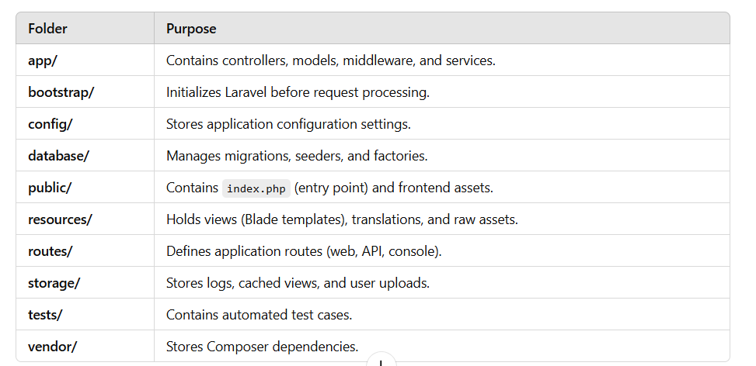
Summary of Laravel File & Folder Structure

Slide 42
Video
https://www.youtube.com/watch?v=L7QxTLhsuVk&ab_channel=CodeStepByStep

